Slide 1
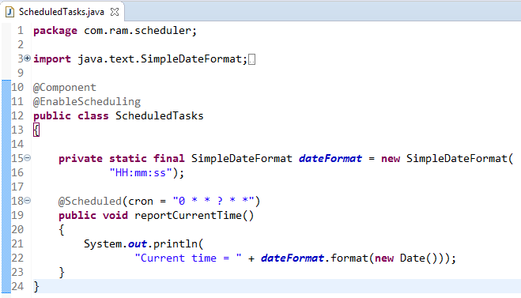
Schedule a Task using Cron Expressions[Configuring scheduled tasks using Annotation]
@EnableScheduling ensures that a background task executor is created. Without it, nothing gets scheduled.
Sometimes delays and rates are not enough, and we need the flexibility of a cron expression to control the schedule of our tasks
In this example, that we’re scheduling a task to be executed on Every minute.
The simple rules that need to be followed to annotate a method with @Scheduled are:
a method should have void return type
a method should not accept any parameters
Hardcoding these schedules is simple, but usually, you need to be able to control the schedule without re-compiling and re-deploying the entire app.
We’ll make use of Spring Expressions to externalize the configuration of the tasks – and we’ll store these in properties files:
@Scheduled(cron = "${cron.expression}")

Slide 2
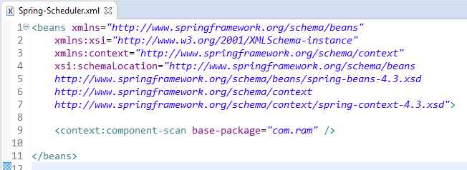
Schedule a Task using Cron Expressions[Configuring scheduled tasks using Annotation]

Slide 3
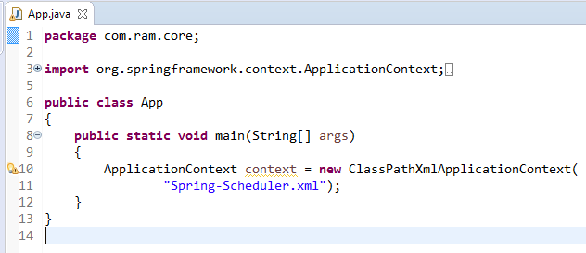
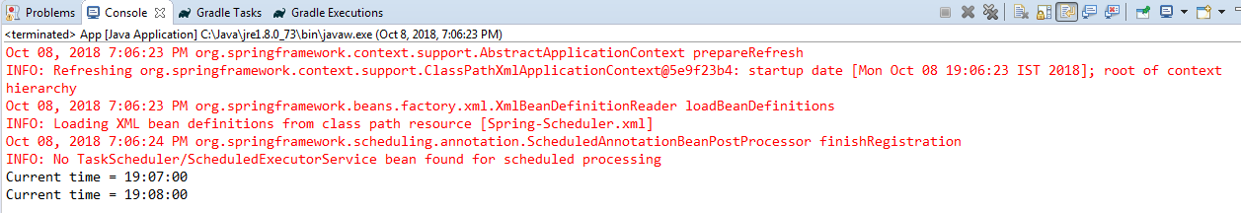
Schedule a Task using Cron Expressions[Configuring scheduled tasks using Annotation]

Slide 4
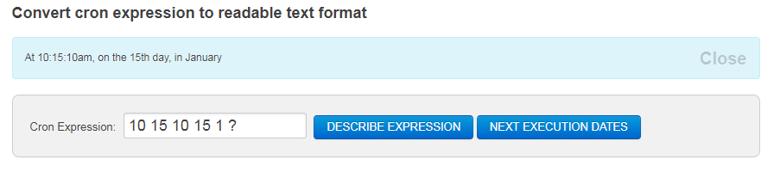
Schedule a Task using Cron Expressions[Configuring scheduled tasks using Annotation]

Slide 5
Schedule a Task using Cron Expressions[Configuring scheduled tasks using Annotation]
https://www.freeformatter.com/cron-expression-generator-quartz.html

